Slide 1
Final design and work in progress
Òscar Meléndez Codina, Jordi Solé, Pol Laguna Soto, Jaime Mariano Servera, Iván García Rodríguez

Slide 2
Web idea
Web-based forum platform, where different users can upload images accompanied by metadata, and other users can comment on those posts.
Architecture used:
Frontend
  React.js
Backend
  Node.js + Express
2 different roles:
Standard User
  Can create, edit, or delete only their own posts and comments.
Admin
  Has full permissions to edit or delete any content on the platform

Slide 3
Security implementations
Certificate
Auth0
Password Protection
Enable secure HTTPS communication
Implementing OIDC, handling authentication and authorization
Hashed passwords
Database Encryption
XSS & SSTI
Prepared Statements
Escape inputs before rendering, secure templates

Slide 4
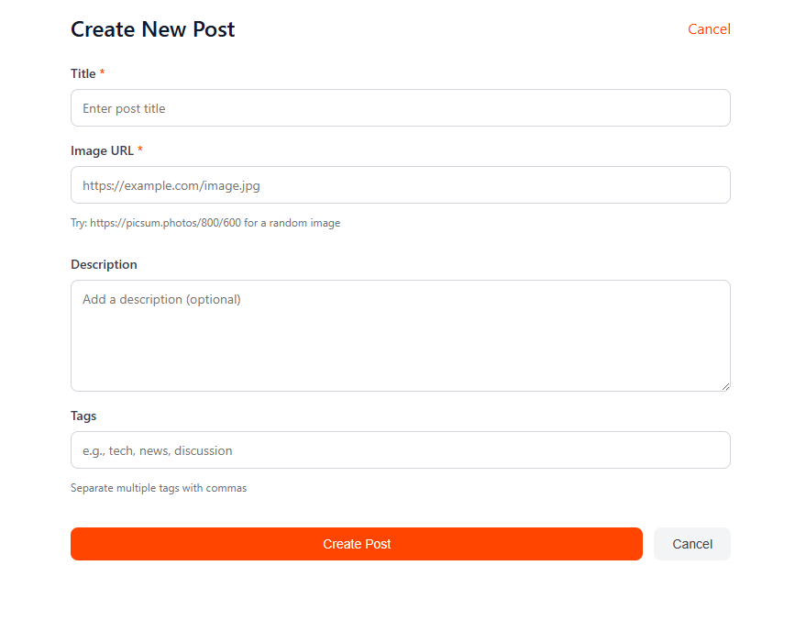
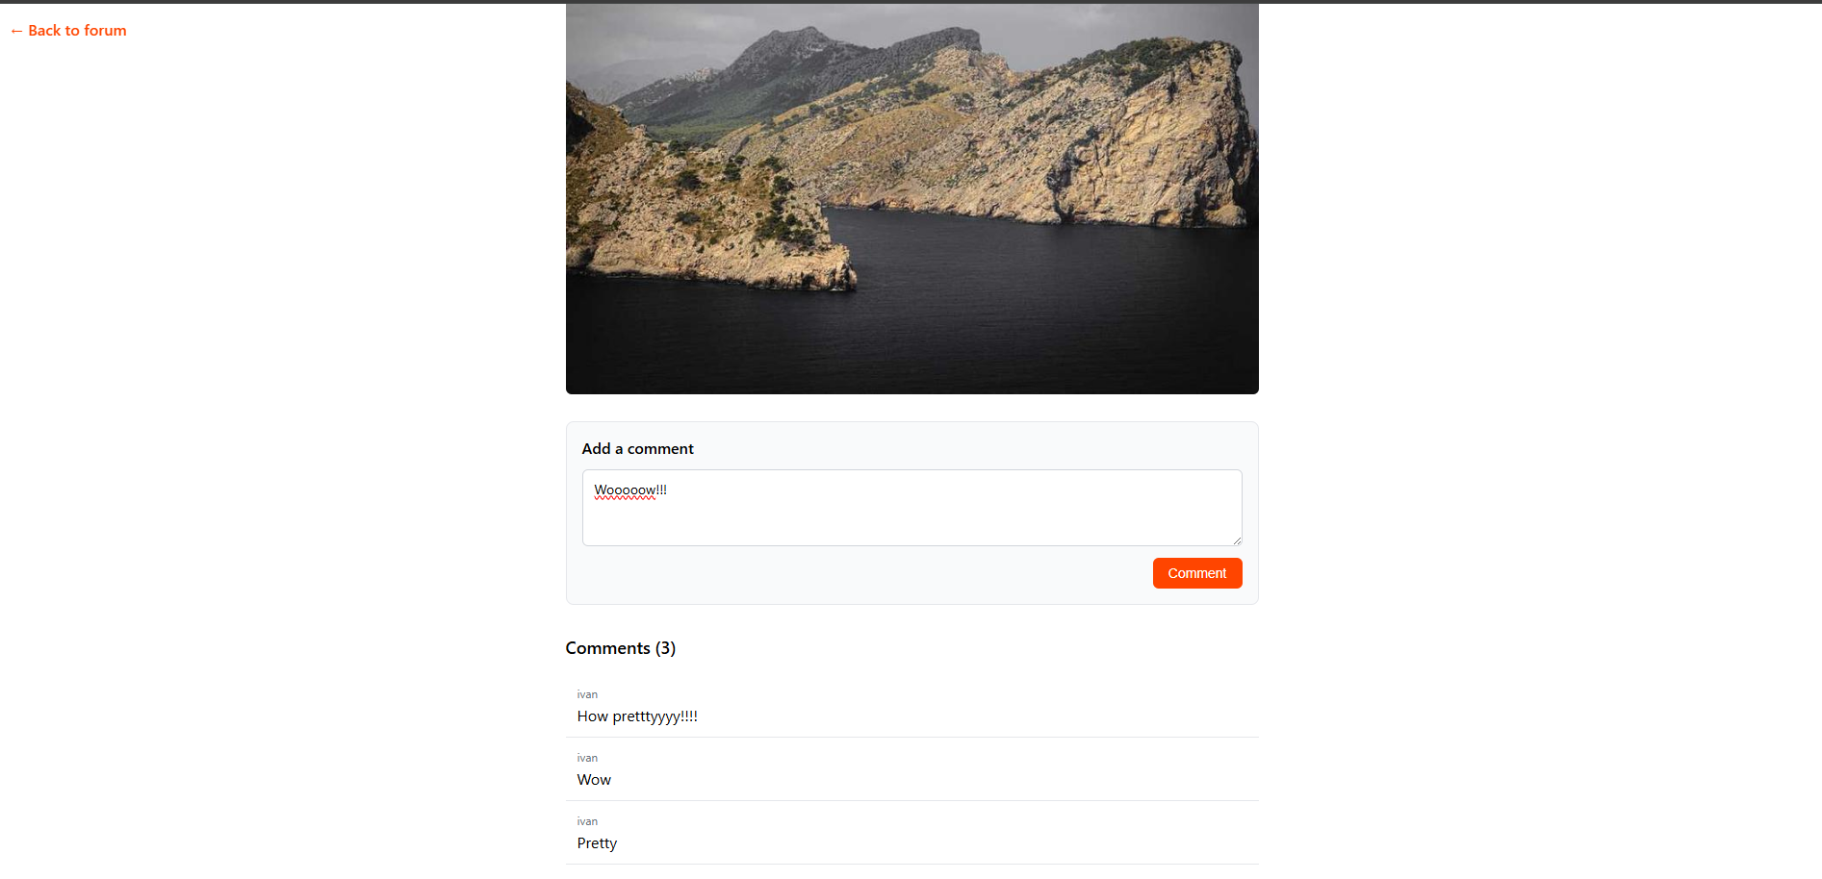
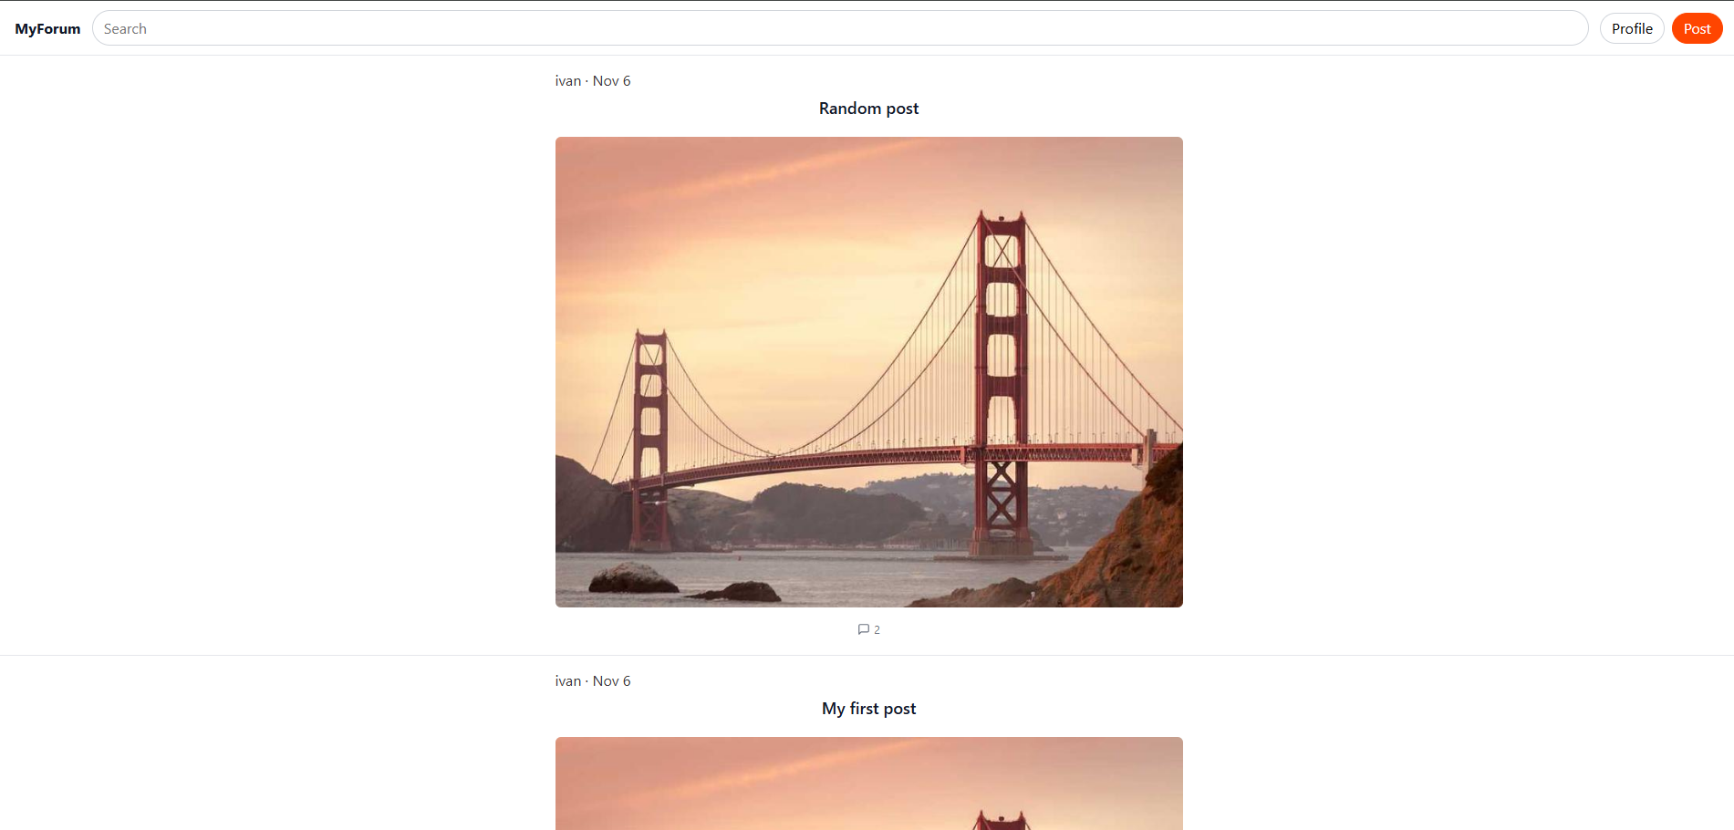
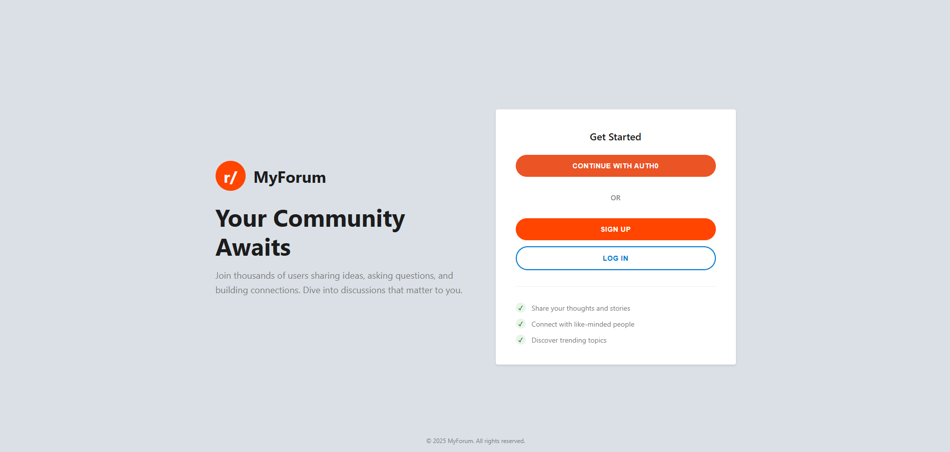
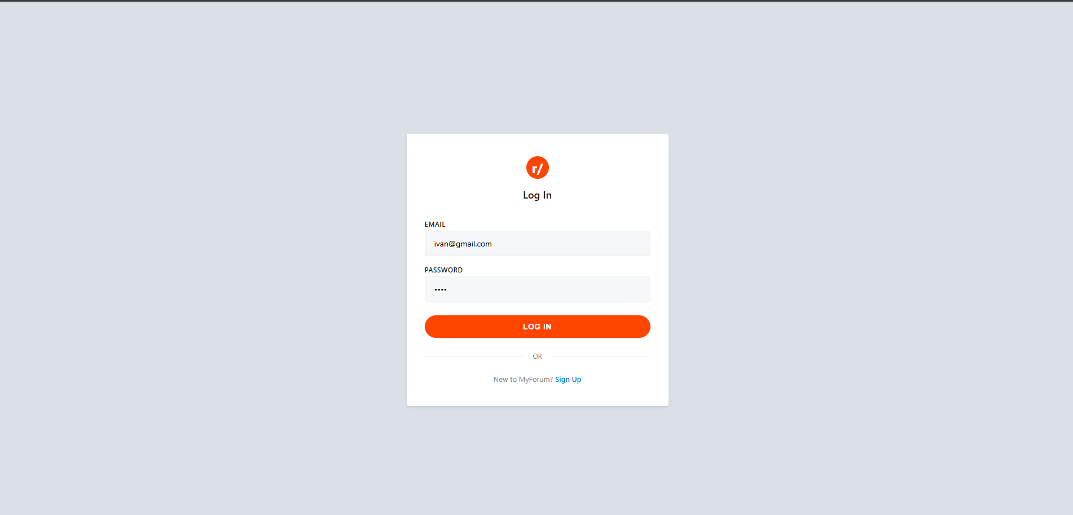
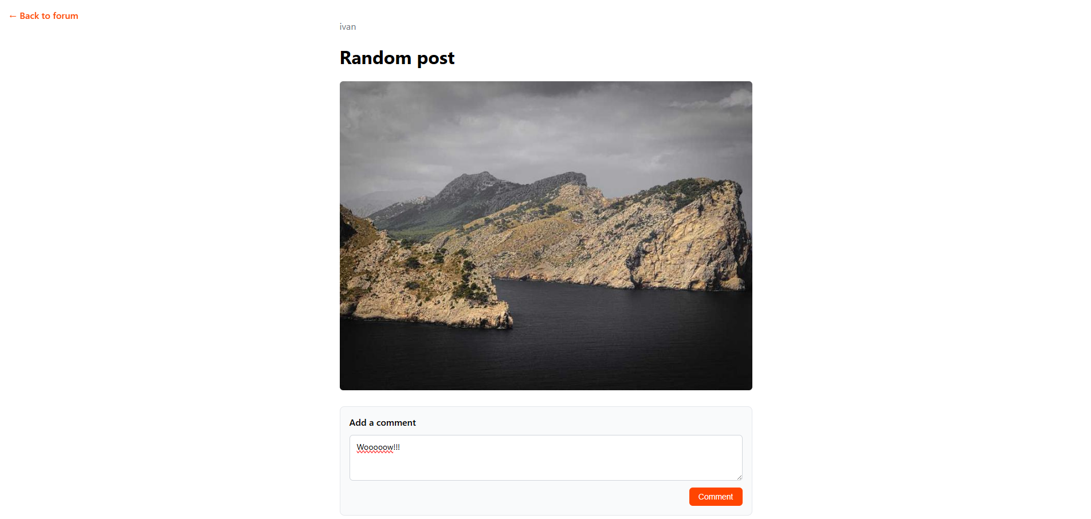
Frontend and Backend
Backend
We have developed the necessary endpoints to ensure the proper functioning of the forum, allowing users to create posts and comments, as well as retrieve all posts or a specific one for example.
Frontend

Slide 5
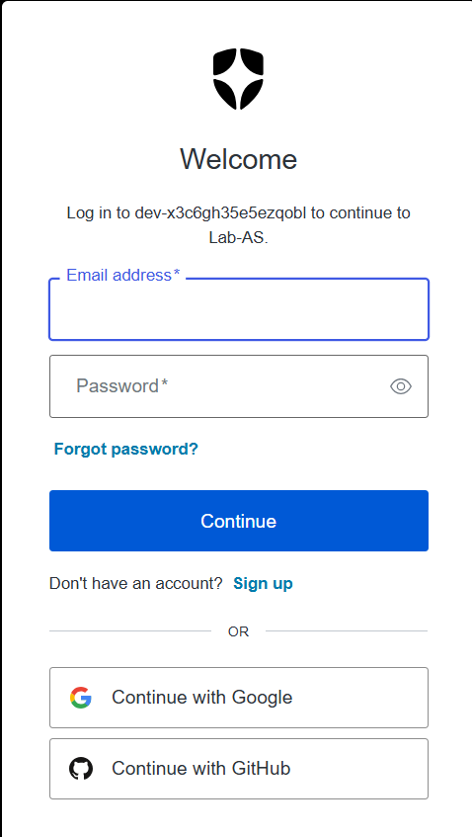
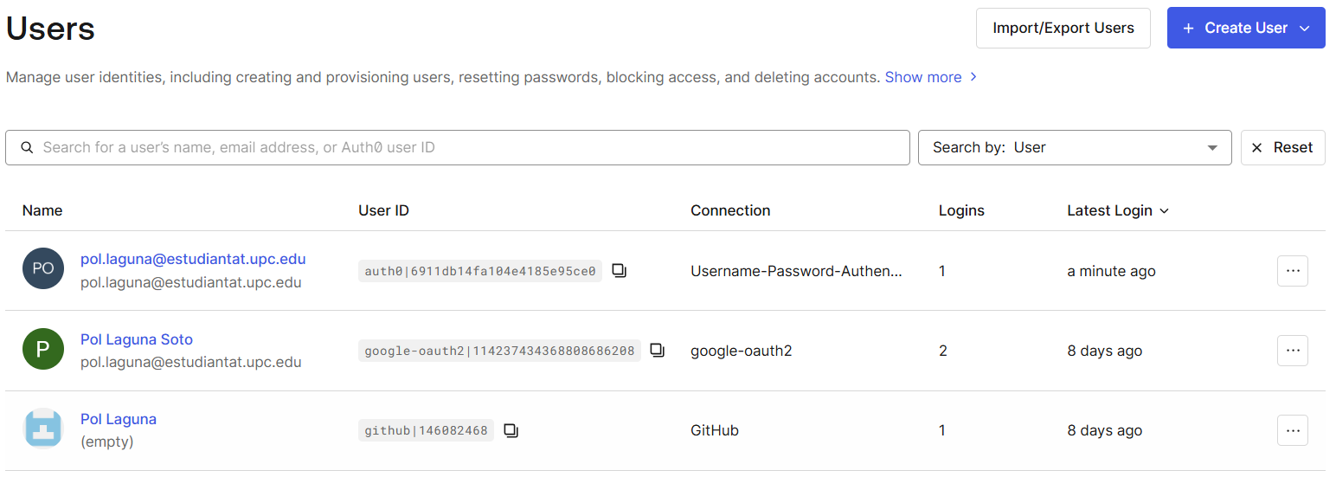
Security implementations
Auth0
Password protection -> Normal user: Auth0 uses bcrypt

Slide 6
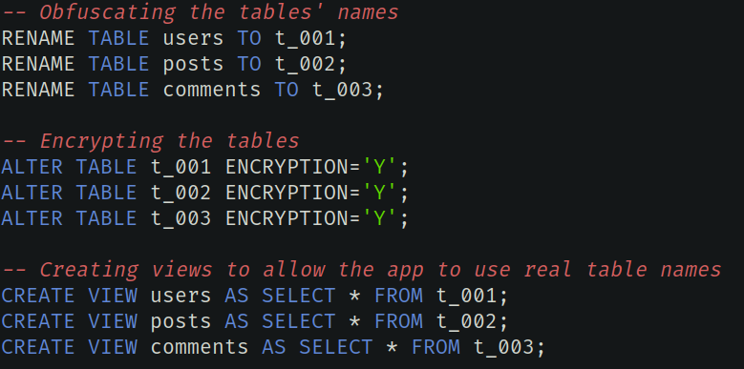
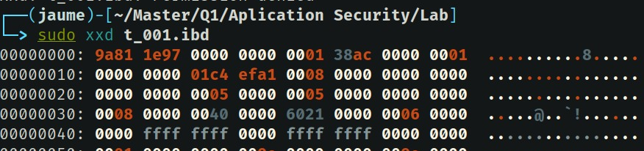
Security implementations
Transparent database encryption and obfuscation at rest
Sanitized inputs to prevent injection attacks

Slide 7
Work To Do
SSL Certificate
Frontend Improvements (Edit Profile Page) - Reduce Impact of SSTI

